Slide 1


Credit Card Fraud Detection
A Robust Approach to Classifying Fraudulent Transactions Using Machine Learning

Slide 2
Introduction
Problem Statement: Fraudulent credit card transactions cause significant financial losses.
Goal: Develop a robust machine learning pipeline for fraud detection.
Key Challenges:
Highly imbalanced dataset (fraud cases: 0.172%).
Maintaining precision and recall for reliable predictions.
Notes:
Class imbalance is a problem because it can cause machine learning models to perform poorly on the minority class, which is often the focus of the analysis, such as detecting fraud.
If fraud accounts for 0.172% of transactions, a model predicting "legitimate" for all cases achieves 99.828% accuracy but detects no fraud.

Slide 3


Dataset Overview
Source: Transactions of European cardholders (September 2013).
Features:
Time: Seconds elapsed since the first transaction.
V1-V28: PCA-transformed features.
Amount: Scaled transaction value.
Class: Fraud (1) or legitimate (0).

Slide 4
Pipeline Overview
Preprocessing:
Scaled numerical features (Amount column).
Handled missing values (none found).
Resampling:
Addressed class imbalance using SMOTE.
Model Training:
Algorithms: Logistic Regression, Random Forest, XGBoost, Neural Network.
Hyperparameter tuning via GridSearchCV.
Evaluation:
Metrics: Precision, Recall, F1-score, ROC-AUC, AUPRC, Confusion matrix.
Notes:
Precision: Measures the accuracy of positive predictions.
Formula: Precision=(True Positives)/(True Positives+False Positives)​
High precision indicates fewer false alarms (false positives).
Recall: Measures the ability to identify all actual positives.
Formula: Recall=(True Positives)/(True Positives+False Negatives)​
High recall means most fraud cases are detected.
F1-Score: Harmonic mean of precision and recall.
Formula: F1=2⋅[(Precision⋅Recall)/(Precision+Recall)]​
Balances precision and recall, especially important for imbalanced datasets.
ROC-AUC (Receiver Operating Characteristic - Area Under Curve):
Measures the model’s ability to separate classes.
Higher values indicate better discrimination between fraud and legitimate transactions.
AUPRC (Area Under Precision-Recall Curve):
Focuses on the balance of precision and recall for imbalanced data.
Better for datasets with rare positive events, like fraud detection.
6. Confusion Matrix:
Displays counts of True Positives (fraud correctly identified), False Positives (non-fraud classified as fraud), True Negatives (non-fraud correctly identified), and False Negatives (fraud missed).
These metrics collectively evaluate a model's effectiveness in detecting fraud while minimizing errors.

Slide 5

Data Exploration
Temporal Analysis:
Time feature shows no significant pattern for fraud prediction.
Weak correlation (-0.0123) between Time and Class.
Class Balance:
Fraudulent transactions pre-SMOTE: 0.172%.
Balanced distribution achieved post-SMOTE for training data.
Data Split:
Training data was resampled using SMOTE.
Test data remained untouched to ensure realistic evaluation.

Slide 6

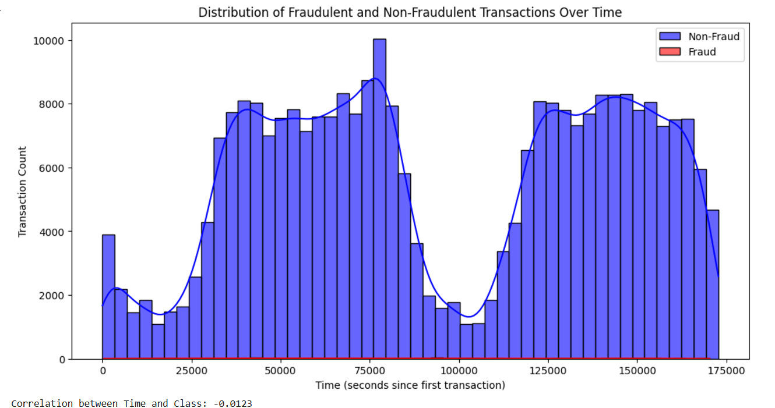
Data Exploration
Temporal Analysis:
Time feature shows no significant pattern for fraud prediction.
Weak correlation (-0.0123) between Time and Class.

Slide 7
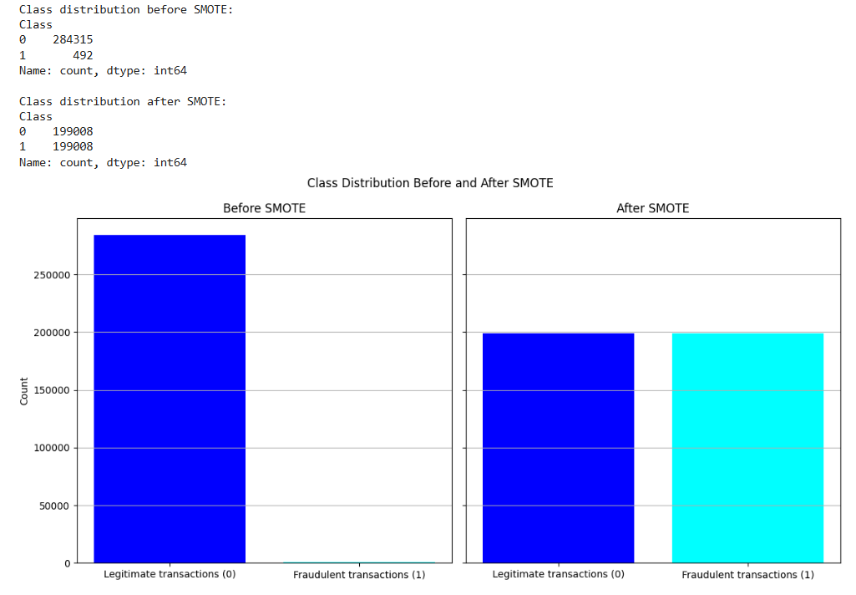
Class Balance:
Fraudulent transactions pre-SMOTE: 0.172%.
Split the data (70% Training, 30% Testing) then applied smote on only the training data.
Balanced distribution achieved post-SMOTE for training data.

Slide 8
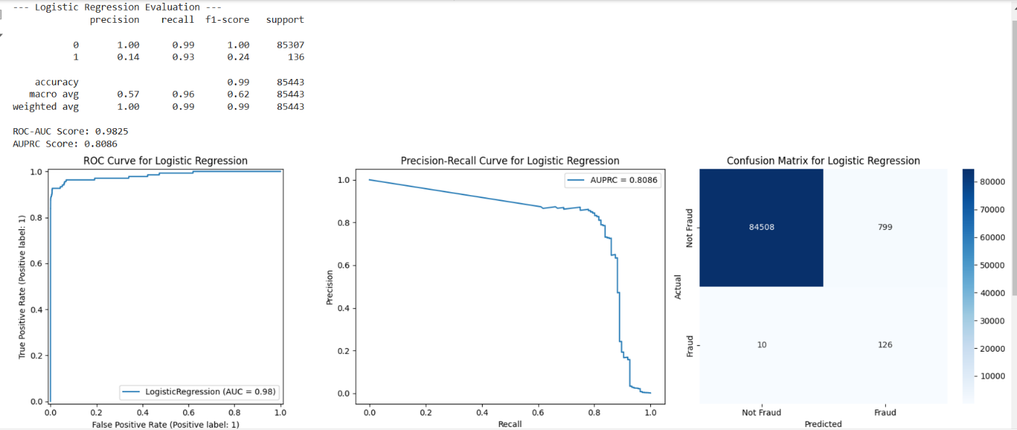
Logistic Regression

Slide 9

Random Forest

Slide 10
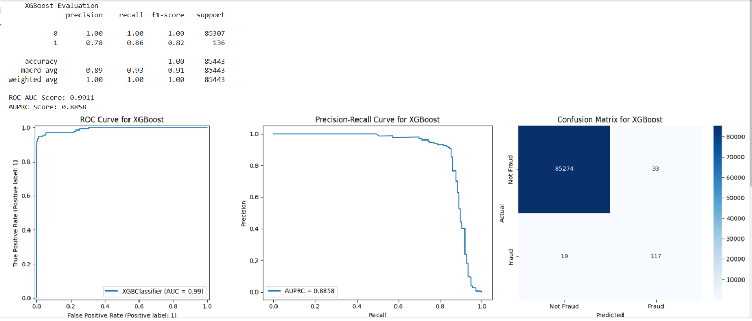
XGBoost

Slide 11
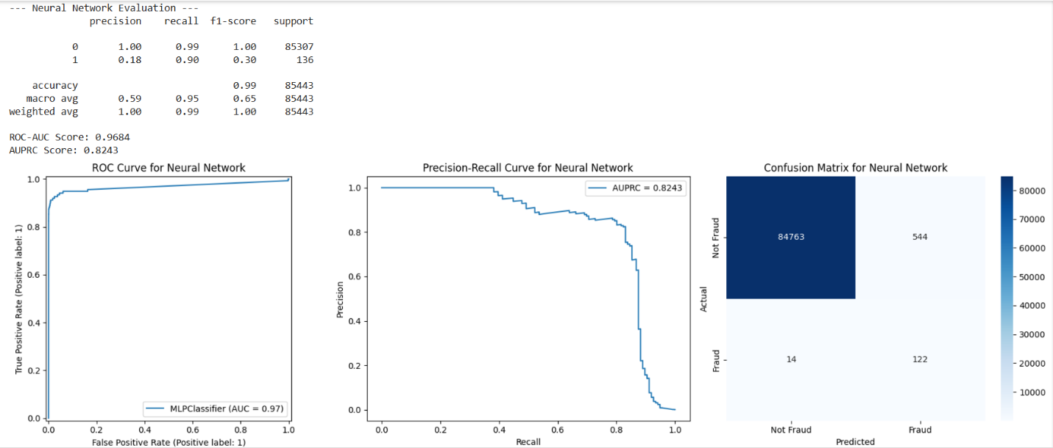
Neural Network

Slide 12
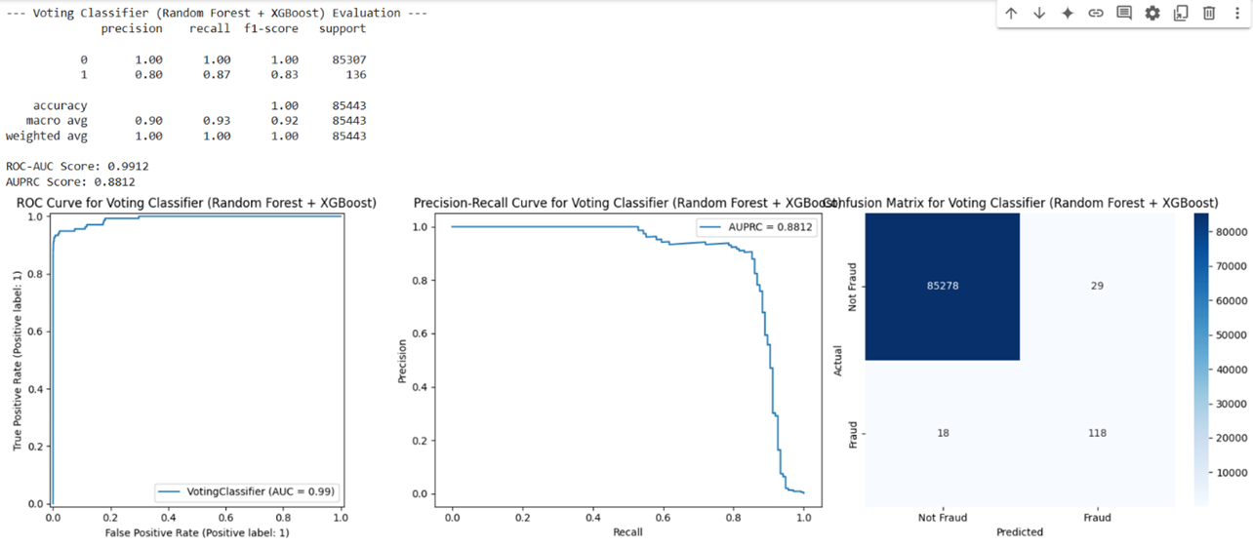
Ensemble Learning (Random Forest and XGBoost)

Slide 13
Model Comparisons
Model | Precision | Recall | F1-Score | ROC-AUC | AUPRC | Key Insights
Logistic Regression | 0.14 | 0.93 | 0.24 | 0.9825 | 0.8086 | High recall but low precision, leading to many false positives. Suitable for initial screening.
Random Forest | 0.80 | 0.88 | 0.84 | 0.9900 | 0.881 | Strong balance of precision and recall with high reliability. Robust for operational environments.
XGBoost | 0.78 | 0.86 | 0.82 | 0.9911 | 0.8858 | Slightly better ROC-AUC and AUPRC than Random Forest, effectively captures complex interactions.
Neural Network | 0.18 | 0.90 | 0.30 | 0.9684 | 0.8243 | High recall but poor precision, leading to frequent false positives.
Ensemble (Voting) | 0.80 | 0.87 | 0.83 | 0.9912 | 0.8812 | Combines strengths of Random Forest and XGBoost, achieving a balanced and robust performance.

Slide 14
Key Findings
Best Performance:
Ensemble (Voting Classifier): Precision (0.80), Recall (0.87), ROC-AUC (0.9912), AUPRC (0.8812).
Strengths:
Combines Random Forest and XGBoost for balanced precision and recall.
High reliability with minimal misclassifications.
Trade-offs:
Logistic Regression has strong recall but low precision.
Neural Networks excel in recall but generate many false positives.

Slide 15
Limitations
PCA-transformed features restrict interpretability.
Synthetic noise introduced by SMOTE may affect real-world application.
Reliance on supervised learning limits adaptability to novel fraud patterns.
Hyperparameter tuning took over 7 hours due to the complexity of evaluating multiple parameter combinations across four models.

Slide 16

Thank you!
Link to Github:
Credit_Card_Fraud_Detection.ipynb
Group members:
Hilda Ogamba
Joyce Malicha
Lynn Obadha

